Slide 1
NEWS ARTICLE SUMMARIZATION FOR YouTube NEWS TRANSCRIPTS
SAI BHARGAVA CHEPPELA
GANGAI KALIPRASAD BHATTULA
VENKATA MAHESH KANUGULA

Slide 2
Introduction
Summarization serves the objective of generating a concise rendition of a source transcript while retaining the essence and crucial information of the original document.
A well written summary can significantly reduce the amount of work needed to digest large amounts of text..

Slide 3
Objective
Developing a model which converts the given News article to summary
Creating a system capable of providing a concise summary of a transcript derived from a given YouTube link using that model

Slide 4
Text Summarization
Text summarization is the process of condensing a given piece of text while retaining its core information and main ideas. The goal is to create a shorter version that captures the essence of the original content. There are two primary approaches to text summarization
1) Extractive Summarization
2) Abstractive Summarization:

Slide 5
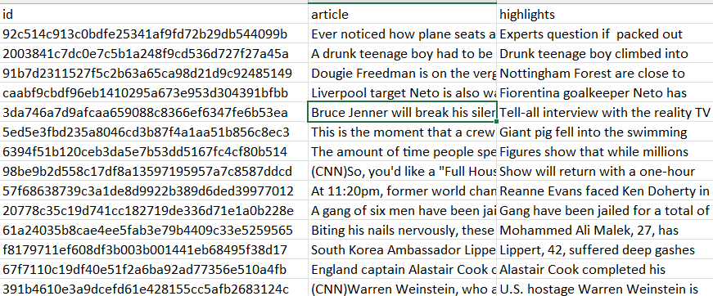
Dataset
https://www.kaggle.com/datasets/gowrishankarp/newspaper-text- summarization-cnn-dailymail
Data feilds:
Id
Article
Highlights

Slide 6
Abstractive Summarization Models
Models like BART (Bidirectional and Auto-Regressive Transformers) and T5 (Text-to-Text Transfer Transformer) can be fine-tuned for abstractive summarization, which involves generating concise and coherent summaries in a more human-like manner.
When compared to other models like GPT-3, BART is a strong candidate due to its sequence-to-sequence architecture designed for tasks like text summarization, where generating coherent and concise summaries is crucial.

Slide 7
APPROACH
Dataset
Preprocessing
Feed the model
Test and save the model
Build an app
Grasp the transcript data from link
Use the model to summarize

Slide 8
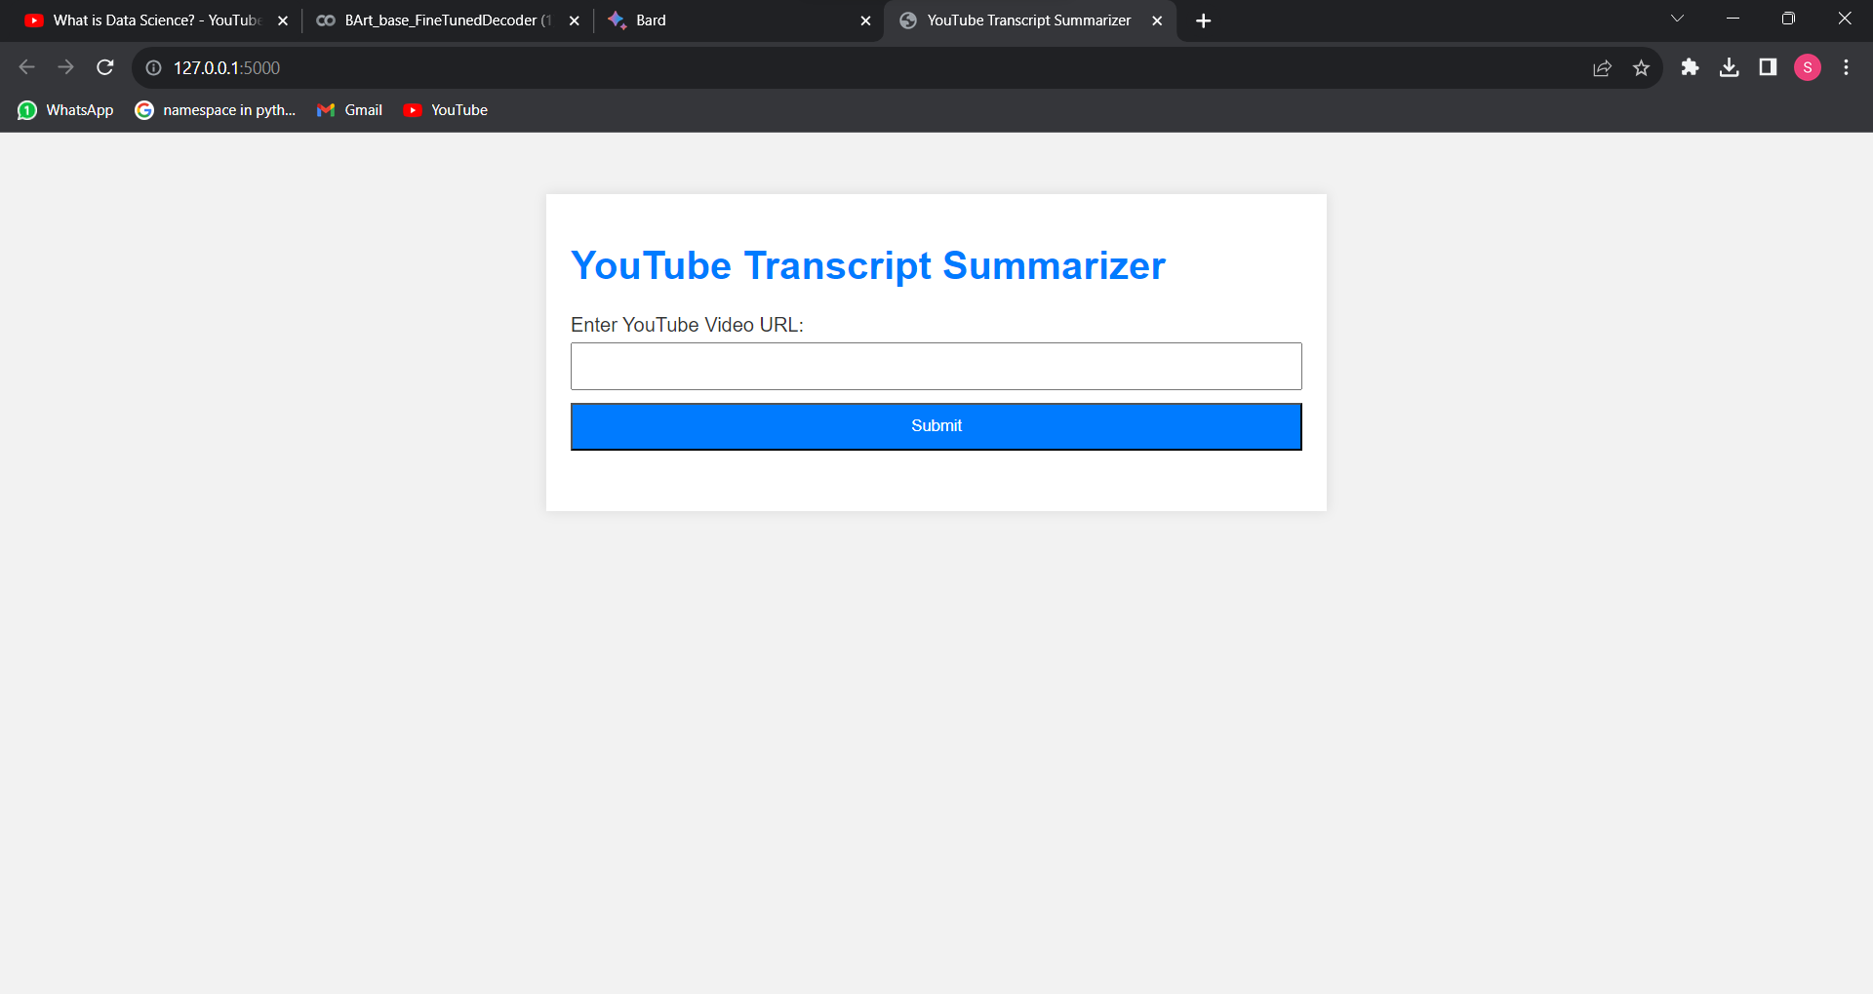
Interface of the app

Slide 9
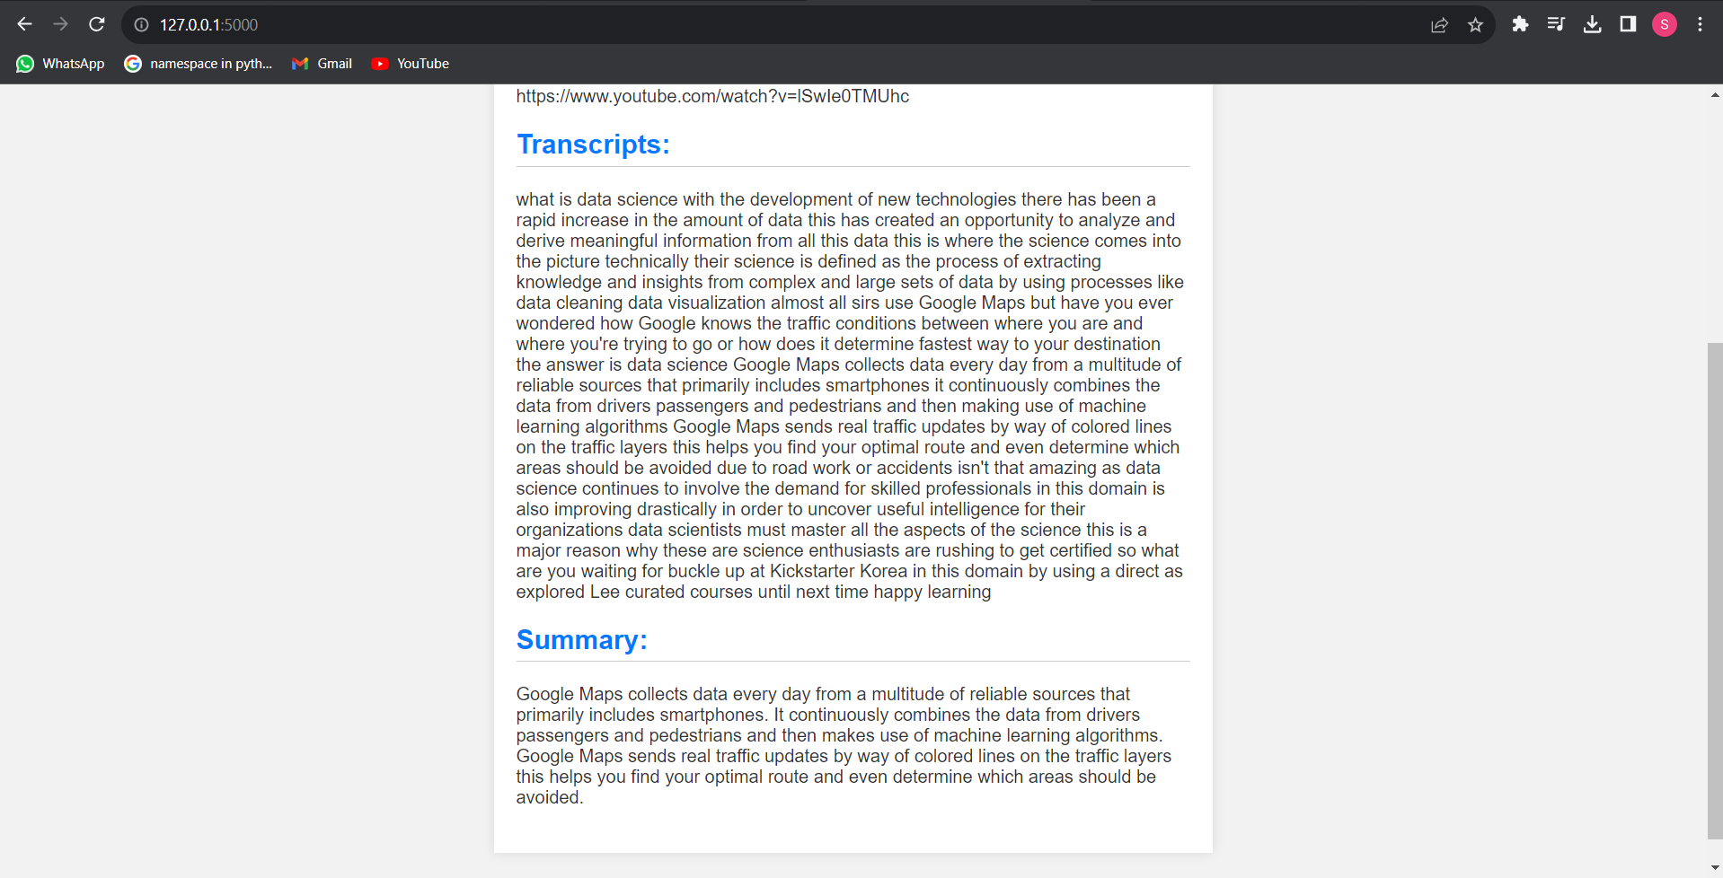

Slide 10
EVALUATION METHODOLOGY
The metric that is used most often in text summarization to measure the quality of a model is the ROUGE score.
ROUGE-N measures the number of matchings ‘n-grams’ between our model-generated text and a ‘reference’

Slide 11
REFERENCE
https://huggingface.co/docs/transformers/tasks/summarization#load-billsum-dataset
https://medium.com/analytics-vidhya/text-summarization-using-nlp-3e85ad0c6349

